Slide 1


Bringing the world to the classroom and the classroom to life
NGL.CENGAGE.COM/ELT
A PART OF CENGAGE

Slide 2

FEATURES
46 Will a robot take your job?
The future of work
48 What’s next?
We hear from people facing life-changing decisions
50 A better life?
One reporter’s view of the economic boom in China
54 Everest tourism changed Sherpa lives
A video about the people who live near Everest
Unit 4-p. 45

Slide 3
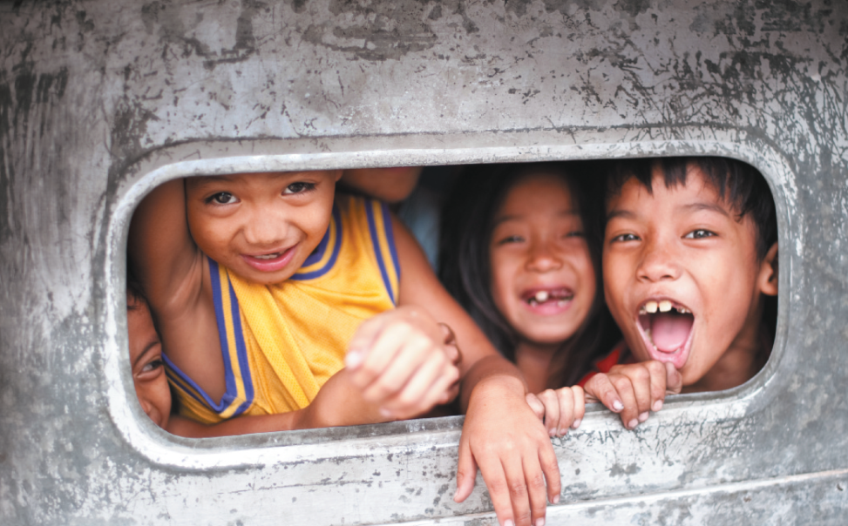
1 Work in pairs. Look at the photo and the caption. What kind of game do you think the children are playing?
EXAMPLE ANSWERS
The children seem to be shouting at people in the vehicle behind them. Games could involve hiding then jumping up at the window to surprise people, or shouting at people to surprise them.
Children play in the back of an old jeepney, the popular public transport vehicle in the Philippines.
2 Did you want to do any of these jobs when you were a child?
Unit 4-p. 45

Slide 4
3 Look at the words that can describe jobs. Are they positive or negative? Which words can describe the jobs in Exercise 2?
Positive: challenging, enjoyable, exciting, responsible, well-paid
Negative: badly paid, boring, dangerous, dirty, stressful
Words that could be used to describe the jobs in Exercise 2:
ballerina: stressful, challenging
film star: exciting, well-paid
firefighter: dangerous, dirty, responsible
footballer: exciting, well-paid
pilot: dangerous, responsible, well-paid
police officer: dangerous, responsible
rock star: exciting, well-paid
scientist: enjoyable, exciting
train driver: badly paid, responsible
vet: responsible, challenging
Unit 4-p. 45

Slide 5

4 Listen to three people talking about their childhood ambitions. Answer the questions for each person.
Track 27
1 Which job did they want to do when they were young?
2 Which job do they do now or do they plan to do?
3 How do they describe the jobs?
Speaker 1
1 superhero or fireman (firefighter) 2 office worker
3 fireman: exciting, dangerous, dirty, challenging
Speaker 2
1 train driver 2 accountant
3 train driver: in charge, responsible
accountant: not very exciting, not as boring as many people think it is
Speaker 3
1 footballer 2 nurse
footballer: well-paid, famous
nurse: not well-paid, quite stressful, enjoyable
5 Work in pairs. Ask and answer the questions in Exercise 4 about your own ambitions.
Unit 4-p. 45

Slide 6
Script
Track 27
1
When I was little I wanted to be a superhero, like in my comic books. I wanted to save the world. When I realized that superheroes aren’t real people, I decided to be a fireman. It seemed like a very exciting job. Now, of course, I realize that it’s dangerous, dirty and extremely challenging. So I’m glad I decided to work in an office – I’m not really very brave!
2
When I was a child, my ambition was to drive a train. My uncle was a train driver and I wanted to be just like him. I liked the idea of being in charge of the train and being responsible for all the passengers. I’m actually an accountant! It’s not a very exciting job – but it’s not as boring as many people think it is.
3
I was really into sports when I was a kid, especially football. My bedroom walls were covered in posters of my favourite footballers. I wanted to be just like them – the best footballer in the world. Footballers were well-paid and famous. But I’m not likely to be a footballer now. I’m training to be a nurse – which is not well-paid and is quite stressful! But in the end I think nursing will be enjoyable. I hope so!

Slide 7

4a Will a robot take your job?
Word focus job and work
1 Look at the sentences. How do we use job and work?
1 A lot of jobs are quite boring, but my job has lots of variety.
2 I’ve worked as a firefighter for ten years – it can be hard work.
4a-p. 46

Slide 8
2 Complete the sentences with the correct form of job or work.
1 Where do you ____________?
2 Do you have an interesting ____________?
3 Do you usually take ____________ home in the evenings?
4 Is your company good to ____________ for?
5 ‘Where’s your boss?’ ‘She’s off ____________ today.’
6 My sister ____________ in the same company as me.
7 I’ll be late home tonight. There are a few ____________ to finish here.
8 ‘Is your brother around?’ ‘No, he’s at ____________.’
work
job
work
work
work
work
jobs
work
3 Work in pairs. Take turns to ask and answer questions 1–4 from Exercise 2.
4a-p. 46

Slide 9

Reading
4 Work in pairs. Look at the jobs. Is your job, or a job you’d like to do, here? Do you think a robot could do these jobs? Why? / Why not?
5 Read the article and check your ideas from Exercise 4.
electrician: possibly – ‘Electricians (65 per cent)’ probability
engineer: no
nurse: no
office worker: yes
taxi driver: possibly – ‘taxi drivers (57 per cent)’ probability
teacher: no
telephone salesperson: yes
4a-p. 46

Slide 10

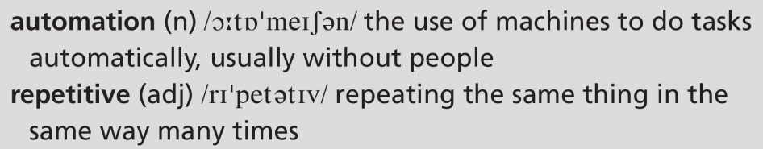
Track 28
How likely is it that you’ll lose your job to a robot? According to Toby Walsh, a professor in Artificial Intelligence, it’s hard to think of a job that a computer won’t be able to do. It’s true that there are already some factories where all the work is done by robots, and there will certainly be more in the future. But what about teachers, engineers and electricians? A team at Oxford University studied 350 different professions and suggested that 35 per cent of UK jobs might go to robots in the next twenty years. In particular, work that is repetitive or involves handling small objects will be at risk of automation. On the other hand, jobs that involve helping other people or having original ideas will probably always need people. So journalists, nurses, engineers and teachers won’t be at risk, but office workers and telephone salespeople may not be so lucky. The Oxford study gives the probability for each of the 350 jobs. Electricians (65 per cent) are more at risk than taxi drivers (57 per cent). One global taxi company says driverless taxis will be on every street corner eventually. However, a spokesperson for London taxi drivers isn’t convinced. ‘It won’t happen. Driverless cars will never be able to work on roads at the same time as normal vehicles.’
You can find out what the future of your profession will be by clicking here.
4a-p. 46

Slide 11
6 Read the article again and say:
1 which jobs are already done by robots
2 what the Oxford University study looked at
3 two types of work that are described
1 jobs in factories
2 how likely 350 different professions are to lose their job to a robot
3 work that is routine or involves handling small objects; jobs that involve helping other people or having original ideas
4a-p. 46

Slide 12
7 Work in pairs. Find predictions for the future in the article about these things. Do the predictions surprise you? Why? / Why not?
1 factory work
2 changes to UK employment
3 engineers
4 taxi drivers
1 There will certainly be more factories in the future where all the work is done by robots.
2 35 per cent of UK jobs might go to robots in the next twenty years.
3 Engineers won’t be at risk of losing their jobs to robots.
4 One global taxi company says driverless taxis will be on every street corner eventually. However, a spokesperson for London taxi drivers isn’t convinced. ‘It won’t happen. Driverless cars will never be able to work on roads at the same time as normal vehicles.’
4a-p. 46

Slide 13
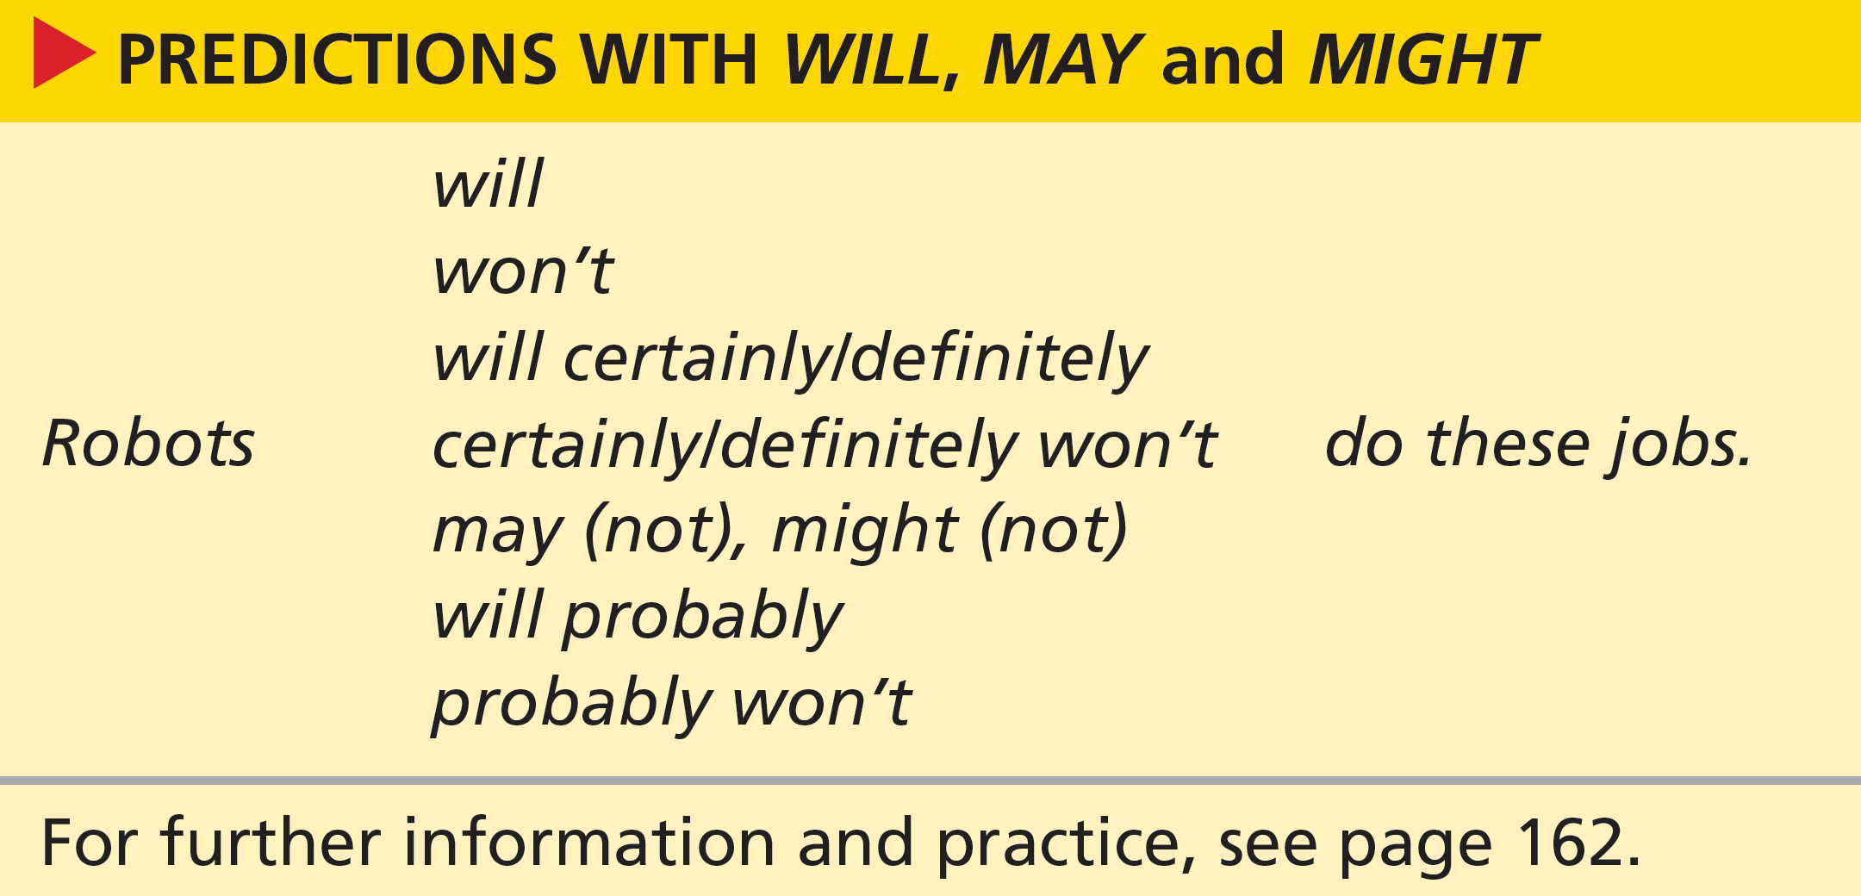

Grammar predictions
4a-p. 47

Slide 14
8 Look at the grammar box. Underline the future forms (verb + infinitive) in the article.
... it's hard to think of a job that a computer won’t be able to do.
... there are already some factories where all the work is done by
robots, and there will certainly be more in the future.
... 35 per cent of UK jobs might go to robots ...
... work that is repetitive or involves handling small objects will be at risk of automation.
... jobs that involve helping other people or having original ideas will probably always need people.
So journalists, nurses, engineers and teachers won’t be at risk ...
... office workers and telephone salespeople may not be so lucky.
One global taxi company says driverless taxis will be on every street corner eventually.
It won’t happen.
Driverless cars will never be able to work on roads at the same time as normal vehicles.
4a-p. 47

Slide 15
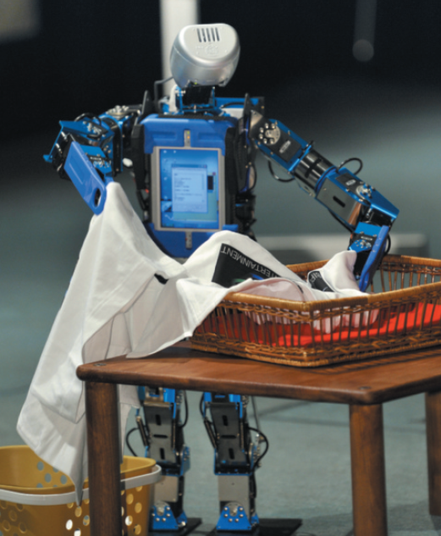
9 Look at the sentences you have underlined in the article. Which two predictions does the writer think are much less certain than the others?
35 per cent of UK jobs might go to robots
office workers and telephone salespeople may not be so lucky.
10 Choose the appropriate option to complete the text about household robots.
The robots are coming, according to robot manufacturers. They say that in five or ten years, we 1 will / won’t all have robots in our homes. Very soon, robots that can cook and fold clothes 2 mightn’t / will be available. In the future, there 3 may / won’t even be robots to babysit our children. Or they 4 may not / might look after our elderly parents and we 5 will / won’t be able to watch them from a computer wherever we are. One thing is certain, we 6 mightn’t / won’t be able to live without the help of robots in several aspects of our lives.
4a-p. 47

Slide 16
11 Cross out the option which is not logical, as in the example, to complete the sentences.
1 Hyundai is building a new factory. They may / will / won’t need more workers.
2 Ravi isn’t very good at his job. He might / mightn’t / won’t get a promotion.
3 I’m bored with my job. I think I may / mightn’t / will look for a new one.
4 The office changes are not important. They mightn’t / will / won’t affect our work.
5 I’ve just bought a car, so I might / will / won’t need to learn to drive soon!
6 Don’t worry about your exam! You may / might / won’t do better than you expect.
4a-p. 47

Slide 17
12 Write predictions as in the example. Use a form from the grammar box. Then compare your predictions with your partner. Do you agree?
My English exam results / good (probably / definitely)
My English exam results will probably be good because I’ve worked hard.
2 Finding a good job / not easy (certainly / probably)
3 People’s salaries / go down (definitely / might)
4 Unemployment / get better (definitely / probably)
5 Environmental problems / get worse (definitely / may)
6 The amount of free time we have / go up (certainly / might)
See next slide for example answers
4a-p. 47

Slide 18
Exercise 12
EXAMPLE ANSWERS
1 My English exam results will probably be good because I’ve worked hard / had a really good teacher.
2 Finding a good job probably won’t be easy because there is a lot of unemployment in the country at the moment.
3 People’s salaries might go down in the next few years because the economy isn’t strong.
4 Unemployment will probably get better because a new factory has been opened in the town.
5 Environmental problems may get worse because people continue to use fossil fuels.
6 The amount of free time we have will certainly go up because the government intends to cut the working week.

Slide 19

Speaking
13 Work in groups. How likely are you to do the following in the next two years? Give reasons. Use future forms from the grammar box in your conversations. Add ideas of your own.
1 buy a motorbike
2 do a degree
3 get a cat
4 get married
5 look for a job
6 make new friends
7 move house
8 travel to a foreign country
A: Are you likely to buy a motorbike in the next two years?
B: Actually, I might buy one this summer. I’d love to do a big road trip across Europe.
See next slide for possible answers
4a-p. 47

Slide 20
Exercise 13
Students’ own answers
Here are some possibilities:
I might do a degree in science. I’ve always been interested in that subject.
I might get a cat. My daughter wants one.
I probably won’t get married. I don’t have a boyfriend right now!
I’ll definitely look for a job. I’m not happy where I am at the moment.
I may make new friends on this course. There are some really nice people in the class.
We’ll probably move house. We want to move to the coast.
I probably won’t travel to a foreign country. I don’t have much money.

Slide 21
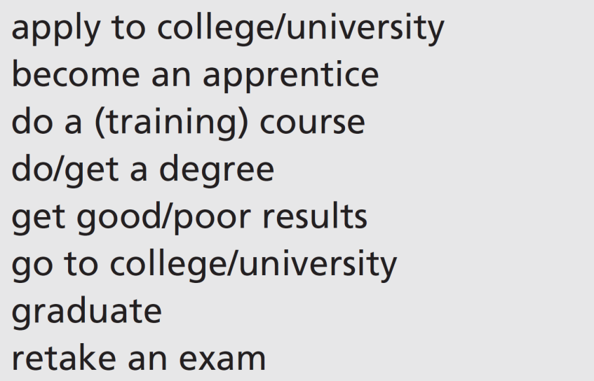
4b What’s next?
Vocabulary education
1 What is your path in education? Look at the expressions and tell your partner what you have done or what you think you will do.
A: When I left school, I applied to college. Then I …
B: I got good exam results, so I think I’ll graduate with a good degree. Then I’ll …
Students’ own ideas. Some possibilities:
I got good exam results, so I think I’ll graduate with a good degree. Then I’ll do a training course in management.
I’ll retake my exams, and hopefully, if I pass, I’ll go to college or become an apprentice. I’ve always wanted to be an electrician.
4b-p. 48

Slide 22
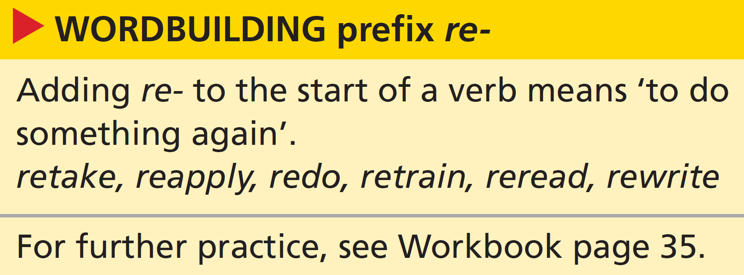
2 Work in pairs. Ask and answer the questions. Ask follow-up questions.
1 Have you ever had to retake an exam?
2 Do you often rewrite your English homework?
3 How many times have you reread your favourite book?
4 Do you know anyone who has retrained for a different job?
4b-p. 48

Slide 23
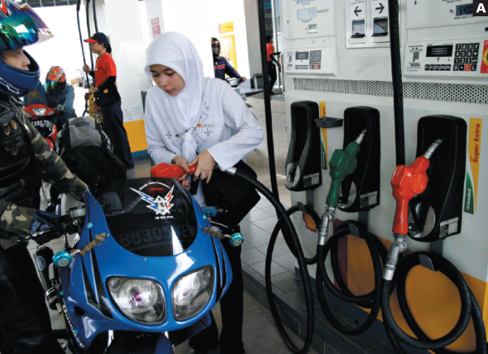
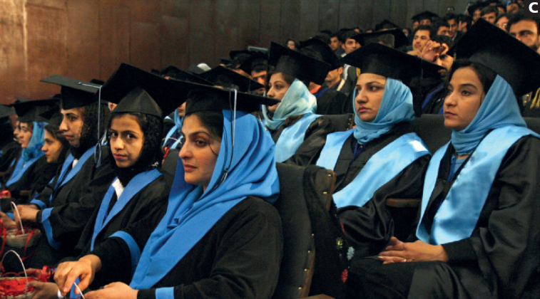

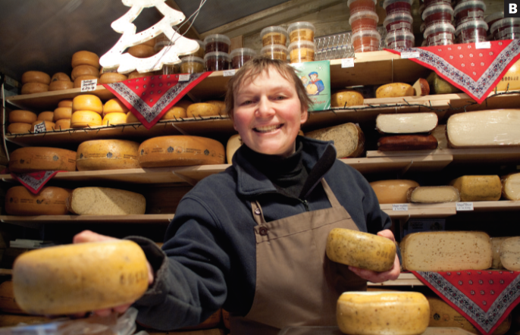


Listening
3 Have you made any important decisions recently? Work in pairs. Tell your partner about one of your decisions.
I’ve decided to change my job. I don’t want to work in an office any more.
4 Work in pairs. Look at the women in the photos. Discuss where you think they are from and what they do.
EXAMPLE ANSWERS
A: she is wearing a headscarf and is likely to be in/from a Muslim country, or from a Muslim community; works in a petrol station
B: looks European; older; works in a cheese shop or a cheese stall in a market; perhaps Dutch or German
C: a group of young Muslim women; they seem to be graduating from college or university
4b-p. 48

Slide 24
5 Listen to an extract from a radio programme celebrating International Women’s Day. Choose the correct option to complete the sentences about the three women featured in the programme.
Track 29
1 Devi works / studies.
2 Devi wants to be a boss / a nurse.
3 Elisabeth has a job / doesn’t have a job.
4 Elisabeth intends to leave her job / retire.
5 Sahera has just started university / graduated from university.
6 Sahera plans to stay in Kabul / leave Kabul.
4b-p. 49

Slide 25
6 Listen to the extract again and correct the factual mistakes.
Track 29
1 Devi isn’t going to stay at home forever.
2 Devi is taking an exam tomorrow.
3 Elisabeth is going to start a new job.
4 Elisabeth is meeting her new boss on Wednesday.
5 Sahera’s friend is going to work in the United States.
6 Sahera’s friend is leaving Kabul next month.
Devi isn’t going to stay in this job forever.
Devi is taking an exam next month.
Elisabeth is going to start her own business.
Elisabeth is meeting the bank manager on Wednesday.
Sahera’s friend is going to study in the United States.
Sahera’s friend is leaving Kabul next week.
7 Which of the three women has decided what she is going to do? Who doesn’t know yet?
Devi and Elisabeth have decided what to do. Sahera hasn’t yet.
4b-p. 49

Slide 26
Script
Track 29
1 Devi is from West Sumatra in Indonesia
D: I didn’t stay on at school, because generally girls don’t here. But then I got this job. I’m the first girl in my family to work outside the home. Since the economic crisis, more women have jobs. I feel very different about my future now. I’m going to change my job. I don’t want to stay in this one forever. I want to train as a nurse, so I’ve applied to college. I hope to get a place on the next course. It starts in January. I’m taking the entrance exam next month. I’m very nervous about it. I haven’t told my boss. I suppose I’ll tell him soon.
2 Elisabeth is from Bruges in Belgium
E: I work in a factory. It’s a good job but the company is making people redundant. So I’m going to take the redundancy package because it’s an opportunity to start again. I got married very young and had a family, so I didn’t finish my education. But I’ve just finished evening classes in business studies, and now I’m going to start my own business. It’s something I already do as a hobby, I make and sell speciality cheeses. Just a moment, I’ll get you some. Here you are, taste this. Do you like it? Well, I’m meeting the bank manager on Wednesday to discuss my business plan. And hey, maybe I’ll take some cheese for him to taste as well!

Slide 27
Script
Track 29
3 Sahera is from Kabul in Afghanistan
S: It’s very difficult to study at university level here. Many girls get no education at all. But we have managed to complete our degrees and graduate from the department of language and literature. Now we’re thinking about the next step. Many of the graduates are going to work as teachers. My friend is going to continue her studies in the United States. I’m going to stay here in the city, because my family is here. I guess I’ll take some time off and visit my parents. And I want to spend time with my friend because she’s leaving next week.

Slide 28
Grammar future forms
8 Look at the sentences in bold in the audioscript on page 182. Find the following.
1 something that is scheduled in a timetable
2 something Devi decides to do as she is speaking
3 something Devi has arranged to do
4 something Devi has already planned to do
1 It starts in January.
2 I suppose I’ll tell him soon.
3 I’m taking the entrance exam next month.
4 I’m going to change my job.
4b-p. 49

Slide 29
9 Read what Elisabeth and Sahera say in the audioscript. Underline at least six other sentences like those in Exercise 8.
1 –
2 (will + infinitive for a decision made at the time of speaking)
Just a moment, I’ll get you some; maybe I’ll take some cheese for him to taste; I guess I’ll take some time off
3 (present continuous for an arrangement)
I’m meeting the bank manager on Wednesday; she’s leaving next week
4 (going to + infinitive for something already planned)
I’m going to take the redundancy package … I’m going to start my own business; Many of the graduates are going to work as teachers; My friend is going to continue her studies in the United States; I’m going to stay here in the city
4b-p. 49

Slide 30
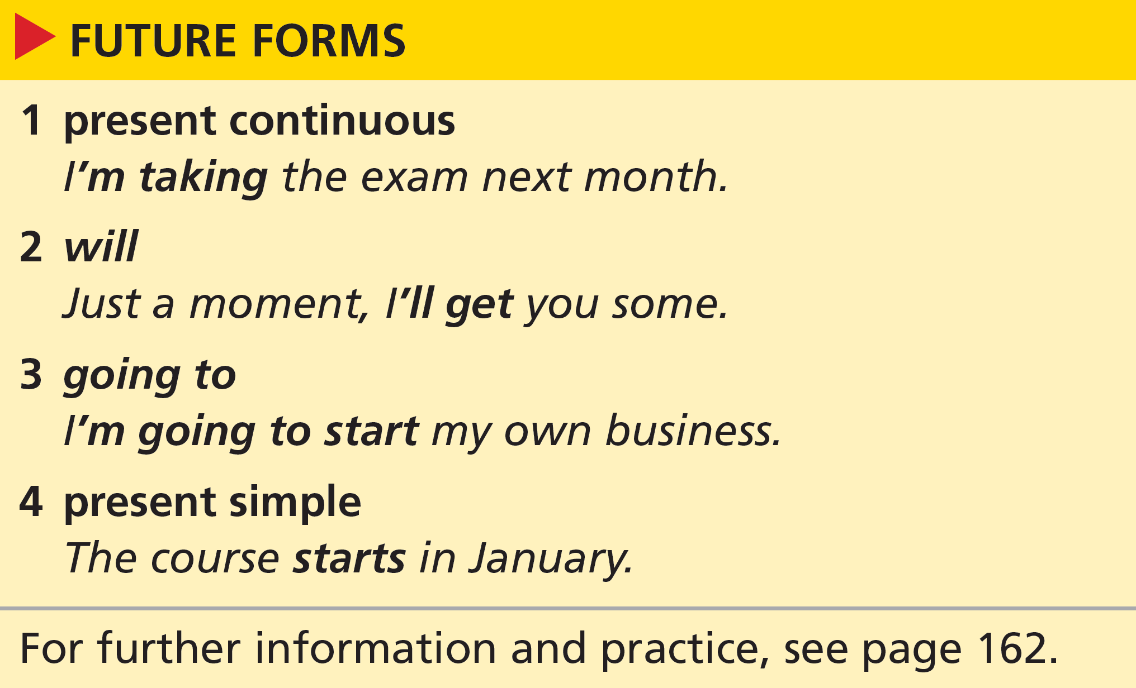
10 Look at the grammar box. Match the future forms (1–4) with the uses (a–d).
3
2
4
1
a a plan or intention decided before the moment of speaking
b a decision made at the moment of speaking
c an event that follows a regular schedule or timetable
d a fixed arrangement to do something at a specified (or understood) time in the future
4b-p. 49

Slide 31

11 Choose the correct option.
I left school last month. 1 I take / I’m going to take the summer off, but in September 2 I’ll start / I’m starting as an apprentice in a garage. 3 I do / I’m doing an evening course as well. That 4 starts / is going to start in October. I’m lucky – some of my friends don’t know what 5 they do / they are going to do. 6 We’ll meet / We’re meeting next week for the first time since our exams. Actually, I think 7 I’ll send / I’m sending them a message about that right now.
4b-p. 49

Slide 32
12 Complete the responses with the most appropriate future form. Then work in pairs. Compare and discuss your answers.
1 A: Have you got any plans for when you leave college?
B: Yes, I _______________ (take) a year off.
2 A: I can’t decide what to do.
B: It’s OK, I _______________ (help) you.
3 A: Is it true that Samira is leaving?
B: Yeah, she _______________ (get) married next month.
4 A: My company has offered me redundancy.
B: _______________ (you / take) it?
5 A: Did you enrol for evening classes?
B: Yes, _______________ (go) to my first class tonight.
6 A: Look, my exam results are here!
B: Give me the envelope. I _______________ (open) it.
See next slide for answers
4b-p. 49

Slide 33
Exercise 12
1 I’m going to take (a plan)
2 I’ll help (a spontaneous intention or offer)
3 she’s getting married (an arrangement – planned and put in the diary)
4 Are you going to take it? (a question about what someone’s plan or intention is)
5 I’m going (to go) (This could be an arrangement: I’ve arranged to go… or a plan: I intend to go…. Native speakers are likely to choose the present continuous as it’s shorter. Speakers tend to avoid saying I’m going to go or I’m going to come.)
6 I’ll open (a spontaneous intention – an offer)

Slide 34
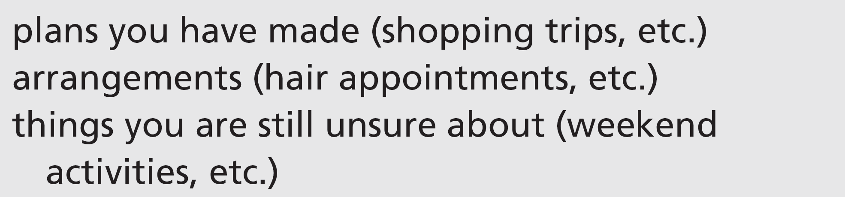
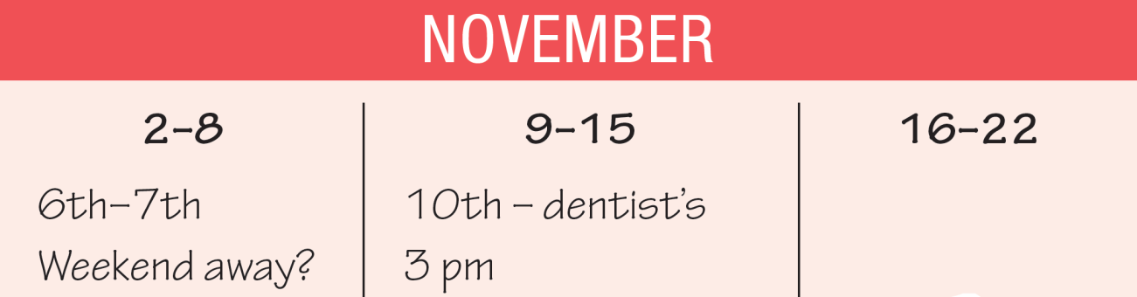
Speaking
13 Draw a calendar for the next four weeks. Write in these things.
14 Work in pairs. You need to meet several times for a project for your English course. Find dates when you can get together.
A: What are you up to next week? Maybe we can get together early in the week.
B: OK. But I’m going to the dentist’s on Monday, so what about Tuesday?
4b-p. 49

Slide 35

4c A better life?
Reading
1 How can these things improve your opportunities in life? Make notes and then compare with your partner.
See next slide for answers
4c-p. 50

Slide 36
Exercise 1
EXAMPLE ANSWERS
The place you go to school: a good school can help you get good qualifications, make good life choices, and make good friends; if a school is good at science, for example, or sport, you are more likely to be interested in and aspire to be good at these subjects; a good teacher can inspire and guide you; discipline at school may make you disciplined – or rebellious.
The place you live: living in a city or in the country can affect your choices and your attitudes; the people you meet and the role models you have are affected by where you live; in a poor or dangerous place, you are more likely to get involved in crime or have low expectations than in a wealthy, safe place.
The career you choose: this affects your wealth, but also how you feel about yourself and others; your career may affect where you live, what sort of lifestyle you have, whether you travel or not, who you meet.
Your family: a loving family usually means you are confident and secure; problems with your family can lead to personal problems; family can help financially and practically in making good life choices; family can be inspiring and supportive or can set bad examples and provide no support.

Slide 37
2 Read the article quickly. Which paragraph(s) talk(s) about these topics?
a training and education
b the movement of people
c the development of new towns
a paragraph 4 (higher education … better training … a huge number of private courses in a Chinese factory town: English classes, typing classes, technical classes)
b paragraphs 1, 2 and 3 (1: men who have come from country villages 2: the arrival of the women 3: Every year about ten million people move to the cities.)
c paragraphs 2 and 3 (2: factories built by the men from the villages; clothes shops and shoe shops appear … you see public services; 3: human energy … the brave entrepreneurs, the quick-moving builders …; Every year about ten million people move to the cities.)
4c-p. 50

Slide 38
3 Read the first two paragraphs of the article. Put these things in the order in which they appear in a new town in China.
3
5
7
1
2
4
6
a street stalls
b cellphone companies
c clothes shops
d construction work
e entrepreneurs
f shops
g female factory workers
4c-p. 50

Slide 39
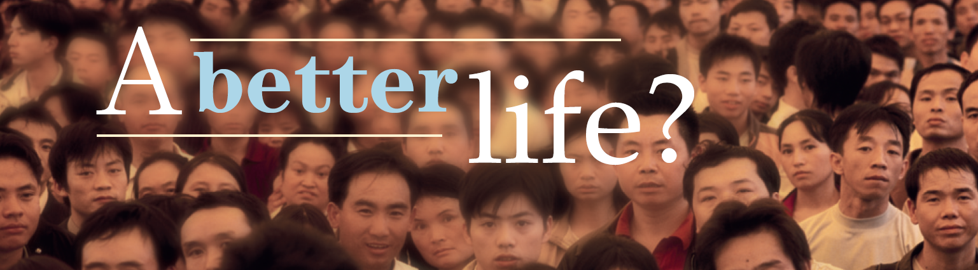
People at Guangzhou Railway Station in Guangdong
Track 30
We spoke to Peter Hessler about his experience of fast-changing life in China.
How does a factory town begin?
The beginning of a Chinese factory town is always the same: in the beginning nearly everybody is a construction worker. They are men who have come from country villages and they are quickly joined by entrepreneurs. These businessmen sell meat, fruit and vegetables on street stalls. Later, the first real shops appear and the same businessmen give up their stalls and start to sell construction materials.
4c-p. 51

Slide 40
What comes next?
Track 30
When the town starts to grow, the cellphone companies arrive. They sell prepaid phonecards to the workers so that they can phone the families they left behind in their villages. When the factories built by the men from the villages start production, you begin to see women. The factory managers prefer to give jobs to young women because they think they are more hardworking. After the arrival of the women, clothes shops and shoe shops appear. And eventually, you see public services, like buses, and so on.
What does it feel like to be there?
The human energy in one of these towns is amazing: the brave entrepreneurs, the quick-moving builders, the young workers a long way from home. A combination of past problems and present-day opportunities has created an extremely motivated population. There are 1.3 billion people in China and 72 per cent of them are between the ages of 16 and 64. And a huge number now live in towns rather than villages. Every year about ten million people move to the cities. Social scientists predict that the urban population will be 60 per cent by 2030.
4c-p. 51

Slide 41
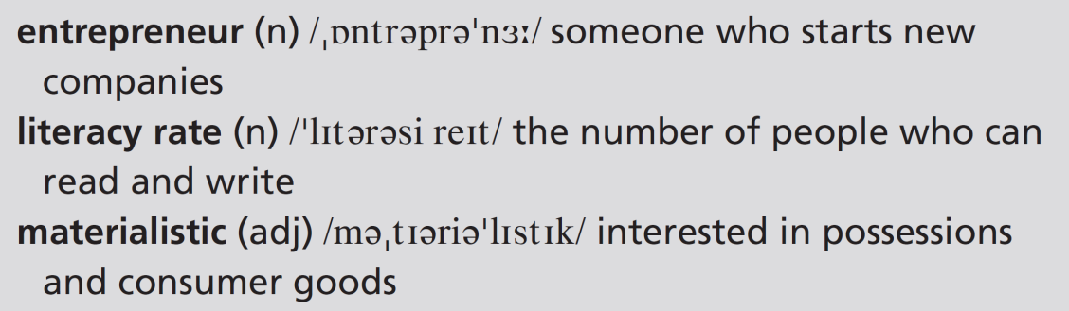
What kind of life do people want?
Track 30
Most people in China have seen their standard of living go up in recent years. Chinese schools have been very successful and the literacy rate is over 90 per cent.
So the next step is to develop higher education because many people are looking for better training. There’s a huge number of private courses in a Chinese factory
town: English classes, typing classes, technical classes. One young man I know couldn’t read or write when he left his village. He now works in a factory and spends a quarter of his wages on training. Another young man I met is learning Arabic and is going to work as a translator for Middle Eastern buyers. People also have dreams of a more materialistic life just as people do in the West. The new factory towns of China have grown in order to make products for the rest of the world. And now, the workers want to be able to have these products for themselves as well.
4c-p. 51

Slide 42
4 Read the rest of the article. Are the sentences true (T) or false (F)?
1 Most of the population in China is school age.
2 About ten million people a year move from their villages.
3 Few school leavers in China are interested in higher education.
4 It’s difficult to find training courses in factory towns.
5 So far, China has focused on making products for foreign markets.
1 F (72 per cent are between the ages of 16 and 64.)
2 T (Each year about ten million rural Chinese move to the cities.)
3 F (So the next step is to develop higher education because many people are looking for better training.)
4 F (In a Chinese factory town, there are many private courses: English classes, typing classes, technical classes.)
5 T (The nation has become successful by making products for overseas consumers.)
4c-p. 50

Slide 43
5 Work in pairs. Do you think that the people in the new towns have a better life than they did in their villages? Why? / Why not?
Students’ own answers.
The text refers to the ‘materialistic dreams of the average Chinese worker’ (in general, people want to go to urban centres for the opportunity to be better paid, have more possessions, have a better education, have a more exciting life).
Students may argue that their lives might not be better though (they may fail to get a job, be exploited, and they may miss traditional ways of life, their family and their friends).
4c-p. 50

Slide 44
Critical thinking the author’s view
6 Authors can show things in a positive, negative or neutral way. Read these extracts from the article and say which one expresses a positive view and which two are neutral. Which words help you decide?
1 When the town starts to grow, the cellphone companies arrive.
2 The human energy in one of these towns is amazing: the brave entrepreneurs, the quick-moving builders, the young workers a long way from home.
3 Another young man I met is learning Arabic and is going to work as a translator for Middle Eastern buyers.
1 neutral
2 positive (amazing, brave, quick-moving, a long way from home)
3 neutral
4c-p. 50

Slide 45
7 Find at least two more sentences in the article in which the author shows his view. What is his view?
EXAMPLE ANSWERS
Here are some sentences that show the author’s overall positive view:
The factory managers prefer to give jobs to young women because they think they are more hard-working.
A combination of past problems and present-day opportunities has created an extremely motivated population.
Most people in China have seen their standard of living go up in recent years. Chinese schools have been very successful and the literacy rate is over 90 per cent.
There’s a huge number of private courses in a Chinese factory town: English classes, typing classes, technical classes. One young man I know couldn’t read or write when he left his village. He now works in a factory and spends a quarter of his wages on training.
8 Work as a class. How do the changes described in the article compare to a place or country you are familiar with?
Students’ own answers
4c-p. 50

Slide 46
Vocabulary pay and conditions
9 Read the sentences. Which jobs can they describe?
1 In this job, people work long hours.
2 Employees get four weeks’ paid holiday a year.
3 Workers get regular pay rises.
4 The salary is excellent.
5 Employees can choose to work flexi-time if they need to.
6 There are lots of opportunities for promotion.
7 Staff often have to work overtime.
8 All employees are covered by a generous pension scheme.
EXAMPLE ANSWERS
Work with students’ answers as there are so many possibilities.
Nurses work long hours, people in the advertising industry get an excellent salary, civil servants get four weeks’ paid holiday and a generous pension scheme, some office workers get flexi-time, there are lots of opportunities for promotion in sales and marketing, doctors and nurses have to work overtime.
4c-p. 50

Slide 47
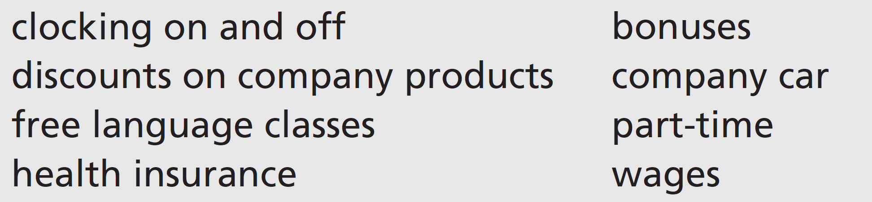
10 Put the words in bold in Exercise 9 into three groups: money (M), hours (H) and benefits (B). Then add these words to the groups.
Money: paid holiday, pay rises, salary, pension scheme, discounts on company products, bonuses, wages
Hours: long hours, flexi-time, overtime, clocking on and off, part-time
Benefits: paid holiday, pension scheme, discounts on company products, free language classes, health insurance, bonuses, company car
4c-p. 50

Slide 48
Speaking
11 Work in pairs. What four things in Exercises 9 and 10 does the perfect job have? Put them in order, 1 to 4. Then compare with a new pair. If you have different things in your lists, discuss them and try to agree on only four.
EXAMPLE ANSWERS
Students may suggest a list such as this: excellent salary, opportunities for promotion, flexi-time and lots of paid holiday
4c-p. 50

Slide 49
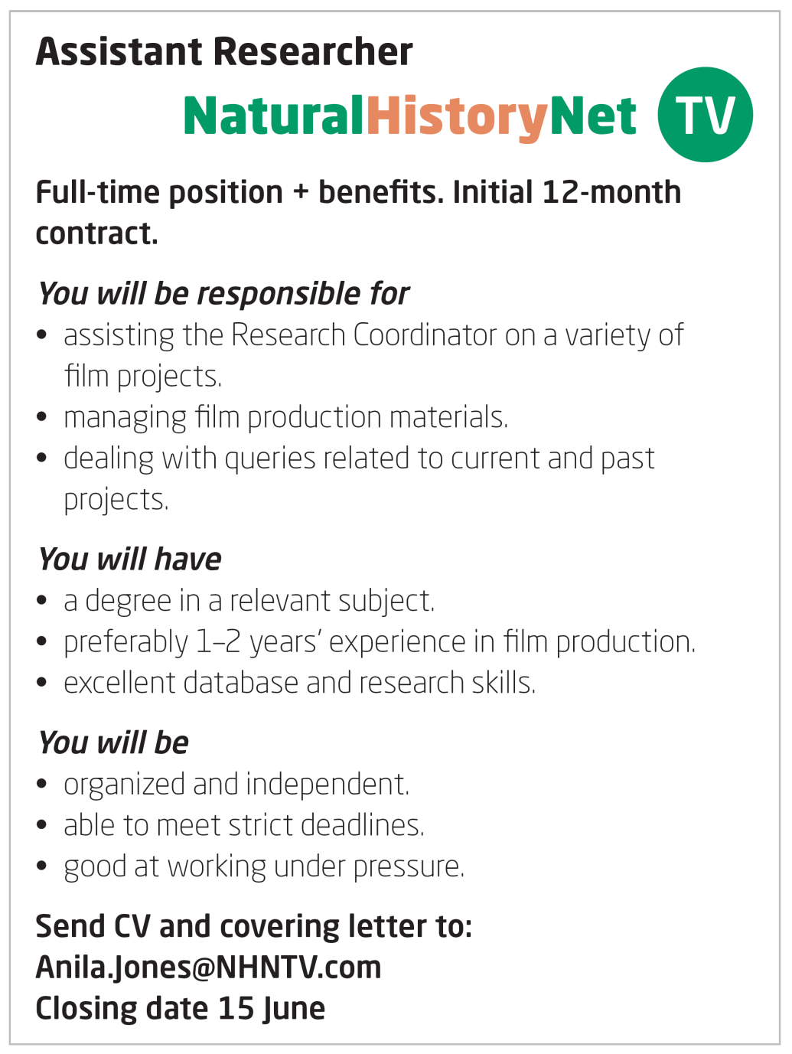
4d Would you mind … ?
Vocabulary job requirements
1 Read the job advert and find the following.
1 duties
2 deadline for applications
3 skills and qualifications required
4 personal qualities required
1 assisting the Research Coordinator, managing film production materials, dealing with queries
2 15 June
3 a degree in a relevant subject, preferably 1–2 years’ experience in film production, excellent database and research skills
4 should be organized and independent, able to meet strict deadlines, good at working under pressure
4d-p. 52

Slide 50

2 Which of these qualities would be useful for the job in the advert?
conscientious, hard-working, methodical, self-confident
3 Work in pairs. Choose three jobs you know something about. What are the most important requirements of those jobs? Compare your ideas.
Students’ own answers
4d-p. 52

Slide 51
Real life making and responding to requests
4 Listen to two friends, Rudi and Mark, discussing the position in the advert. Answer the questions.
Track 31
1 Does Mark meet all the requirements?
2 Is his CV ready?
3 What will he need for the interview?
yes
no
smart clothes, a suit
4d-p. 52

Slide 52
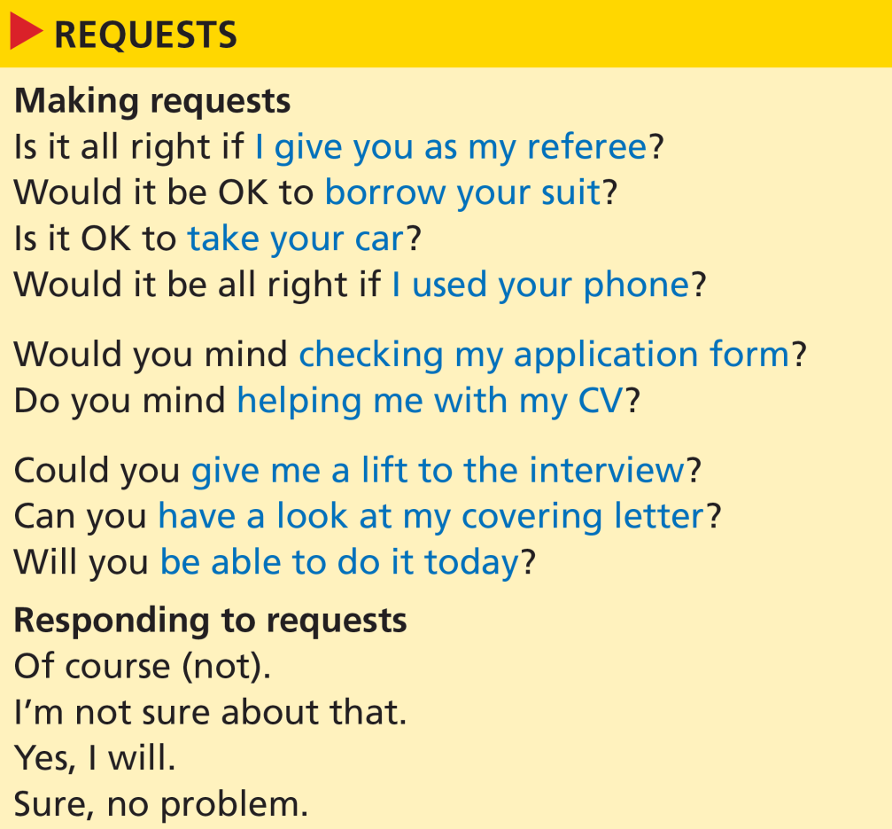
5 Look at the expressions for making and responding to requests. Listen again and tick the expressions Rudi and Mark use.
Track 31
✓
✓
✓
✓
✓
✓
✓
✓
✓
✓
6 Would you like to do a job like the one in the advert? Why? / Why not?
4d-p. 52

Slide 53
Script
Track 31
R = Rudi, M = Mark
R: This looks interesting – this assistant researcher job for a TV company.
M: I know, the only thing is the experience. They want two years, but I’ve only worked part-time for a year, really.
R: One or two years’ experience it says, and anyway you meet the other requirements. You’re good under pressure and with deadlines – you always hand your essays in on time at college!
M: That’s not the same thing!
R: Of course it is. And you’re really well-organized, hardworking, highly motivated …
M: OK, OK, if that’s what you think … is it all right if I give you as my referee?
R: Hmm, I’m not sure about that. I don’t think you can just put down your friends’ names.
M: I know, shame! But seriously, do you mind helping me with my CV? I need to make it look a bit more professional.
R: Of course not. Are you going to apply for this job, then?
M: Yeah, I think I will. But I’ll need my CV anyway, whichever job I apply for.

Slide 54
Script
Track 31
R: OK, print it out and I’ll have a look at it.
M: Will you be able to do it today?
R: Yes, I will. But what’s the hurry?
M: The closing date for applications is in a couple of days. Oh, can you have a look at my covering letter too?
R: Have you already written it?
M: No, but I’ll do it this afternoon and then I can send everything off tonight. Hey, they might ask me to go for an interview this week!
R: Yeah, they might.
M: But I haven’t got any smart clothes! Would it be OK to borrow your suit?
R: Sure, no problem.

Slide 55
7 Pronunciation weak and strong auxiliary verbs
a Listen and repeat the exchange. Notice how the auxiliary verb will is not stressed in the full question and is stressed in the response.
Track 32
A: Will you be able to do it today?
B: Yes, I will.
b Match the questions (1–6) with the responses (a–f). Then listen and check. Work in pairs. Practise the exchanges.
1 Are you going to apply for the job?
2 Will he help you with your CV?
3 Are they still advertising that job?
4 Does she meet our requirements?
5 Will it be an all-day interview?
6 Is it OK to phone you at work?
e
d
c
a
b
f
a I don’t think she does.
b I think it might.
c No, they aren’t.
d Of course he will.
e Yes, I think I will.
f Yes, of course it is.
4d-p. 52

Slide 56
8 Work in pairs. You are going to act out short conversations in different situations. Turn to page 155.
4d-p. 52

Slide 57
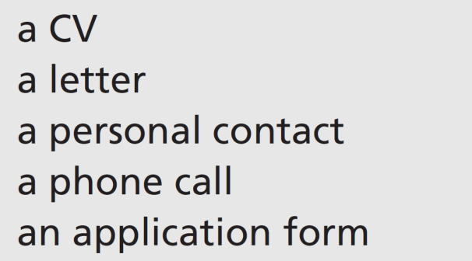
4e I enclose my CV
Writing a covering letter
1 Work in pairs. Which do you think is the most common way to apply for a job? Tell your partner.
Students’ own ideas
4e-p. 53

Slide 58
2 Read the covering letter in reply to the advert on page 52. Match the information (a–j) with the parts of the letter. What (if any) information can you leave out if you send the letter as an email?
a a reference to your CV
b the date
c the name and address of the person you are writing to
d the reason for your letter
e your address
f your interest in the position
g your phone number
h your qualifications
i your relevant experience
j your skills
in paragraph 4
at the top right of the letter, under the sender's address
at the top left, below the sender's address and the date
in paragraph 1
at the top right
in paragraph 1
in paragraph 4 ('contact details')
in paragraph 4
in paragraphs 1, 2 and 4
in paragraphs 2 and 4
In an email, you don’t need to include your address or that of the person you are writing to. You also don’t need to include the date as this will already feature as part of the email header.
4e-p. 53

Slide 59
27 Harbour Road
Manchester
M21 7PF
7 July 2017
NHN TV
Burton House
Bristol
BS9 2HL
Dear Ms Jones,
I am writing in reply to your advertisement in the Daily Herald for the position of Assistant Researcher. I will graduate in Digital Media this month from Manchester University. I have experience in film production and post-production as I have worked parttime in my university television station for the last year.
I consider myself to be hard-working and organized in my work. As part of my job with the university television station, I was responsible for planning schedules and programme archiving.
4e-p. 53

Slide 60

I am available for interview at any time and available to start work after July. I am willing to relocate if necessary.
I enclose my CV which gives full details of my qualifications, work experience and skills as well as my contact details.
I look forward to hearing from you.
Yours sincerely,
Mark Nolan
4e-p. 53

Slide 61
3 Compare the letter to the style you use in your country. Answer the questions.
1 Is the layout different? How?
2 Does it include the same information?
3 Is the information in the main part of the letter sequenced in the same way?
Students’ own ideas
4e-p. 53

Slide 62
4 Writing skill formal style
a A formal letter in English uses these features. Underline examples of each one in the letter.
1 concise sentences
2 formal phrases to begin sentences
3 no contractions
4 standard phrases to open and close the letter
1 Concise sentences: I will graduate in Digital Media this month from Manchester University.
2 Formal phrases to begin sentences: I am writing in reply to …; I consider myself to be …; I am available for interview …; I enclose my CV; I look forward to hearing from you.
3 No contractions: I am writing; I will graduate, I have worked; I am available; I am willing
4 Standard phrases to open and close the letter: Dear Ms ... ; Yours sincerely
4e-p. 53

Slide 63
b Rewrite the sentences in a more formal style.
1 I’ll finish my degree soon.
2 Give me a call.
3 I was looking through the paper and I saw your ad, and I thought it looked really interesting.
4 My phone number is on my CV, which I’ve sent you as well.
5 I’ll be free from August.
1 I will finish my degree soon.
2 I look forward to your call.
3 I am writing in reply to your advertisement in the newspaper.
4 I enclose my CV, which gives my contact details.
5 I am available from the start of August.
4e-p. 53

Slide 64
5 Write a covering letter to go with an application for a job you would like. Follow the layout and style of the letter from Mark.
6 Exchange letters with your partner. Use these questions to check your partner’s letter.
• Is it clear how to contact this person?
• Is the style appropriate?
• Does the person sound like a good candidate?
7 On the basis of the letter your partner has written, would you give him/her an interview? Explain your reasons to your partner.
4e-p. 53

Slide 65
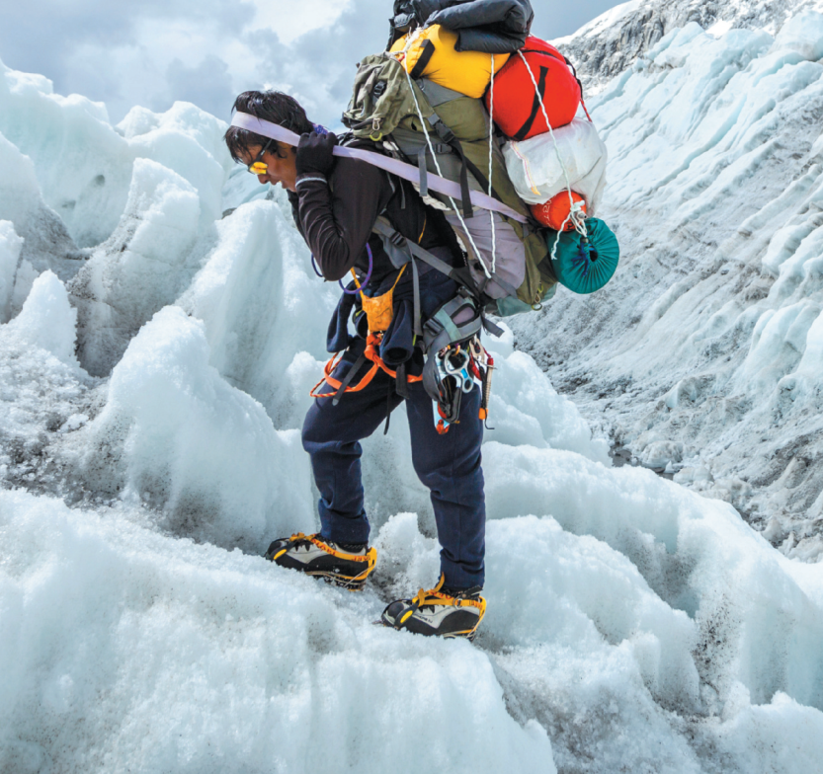
4f Everest tourism changed Sherpa lives
Without Sherpas, it is impossible for people to climb Everest.
Before you watch
1 Look at the photo and read the caption. Where do Sherpa people live? What is the area famous for?
Sherpa people live in Nepal / in the Himalayas / near Mount Everest.
The area is famous for mountaineering.
2 Work in pairs. Do you think Everest tourism is a good thing or a bad thing for Sherpas? Give your reasons.
EXAMPLE ANSWERS
Good things: work, money, maintaining their way of life
Bad things: too many outside influences, changing traditional way of life
4f-p. 55

Slide 66
3 Key vocabulary
a Read the sentences. Try to guess the missing words.
1 Some people do two jobs to increase their _______________.
2 My _______________ is very different to my parents’ generation. They live quite simply.
3 One per cent of the world’s population owns forty per cent of the world’s _______________.
4 There are _______________ differences between my first job and my current job – it was a big shock at first.
5 I’m training to go on the next international _______________ across Antarctica.
6 We live in an _______________ society, and mainly keep sheep and cows.
4f-p. 55

Slide 67
b Read the words in bold and their definitions. The words are used in the video. Complete the sentences in Exercise 3a with the words.
a agrarian (adj) based on farming
b expedition (n) an organized exploration or journey
c income (n) the money that you earn from a job
d lifestyle (n) the way a person lives, the typical things they do and own
e substantial (adj) large and important (quantity)
f wealth (n) the money a person has
1 income
2 lifestyle
3 wealth
4 substantial
5 expedition
6 agrarian
4f-p. 55

Slide 68

While you watch
4 Watch the video. Check your ideas from Exercise 2.
Students’ own answers
5 Watch the first part of the video (0.00–1.33) again. Match the beginnings of the sentences (1–4) with the endings (a–d).
d
c
a
b
1 The Sherpa
2 The name Sherpa
3 The Sherpa culture
4 Sherpa society now
a changed in 1953.
b has mobile phones and the internet.
c means ‘Easterner’.
d are one of seventy ethnic groups in Nepal.
4f-p. 55

Slide 69

6 Work in pairs. Look at the list of things Sherpas have gained and lost. Write G or L. Then watch the second part of the video (1.34 to the end) again and check your answers.
G
G
G
G
L
L
1 education
2 healthcare
3 clothing
4 wealth
5 a simple life
6 happiness
4f-p. 55

Slide 70
Videoscript
Everest tourism changed Sherpa lives
Part 1
0.00–0.24 Conrad Anker The Sherpa are one of seventy ethnic groups within Nepal and they migrated over from Tibet. Their name means ‘Easterner’. So, they came over the mountains and they settled the higher regions of the Himalayas. And, just by chance of living where they have, they’ve become connected to mountain climbing.
0.25–0.44 The Sherpa culture fundamentally changed in 1953, sixty years ago, when Tenzing Norgay and Sir Edmund Hillary climbed Everest. And at this point, it went from their very rural idyllic lifestyle to one being in the twentieth century, and now the twenty-first century.
0.45–1.10 Karma Tsering When Hillary summitted Everest, he gave the Sherpas watches as a bonus. We learned how to tell time using those watches.
1.11–1.33 Anker Within the span of three to four generations, they’ve gone from a very much agrarian, pastoral society with few things that we take for granted, to a society now that has connected with mobile phones, and the internet, and jet travel, and interaction between many more humans.

Slide 71
Videoscript
Everest tourism changed Sherpa lives
Part 2
1.34–2.10 Max Lowe The changes that I saw just in the last ten years were pretty substantial. As far as what people told me they had seen, as far as change, education was a big one; healthcare: there’s a dentist there; there’s medical clinics; the clothing is better. Kancha Sherpa, who, was actually on the 1953 expedition, he was a really interesting guy to talk to. He has seen pretty much the whole field of changes that have occurred.
2.11–2.41 Kancha Sherpa The change has been good because it has brought wealth. Life now feels a little rushed but the people here earn an income. My only worry is global warming because it doesn’t snow much on the mountain anymore.
2.42–3.10 Lowe A lot of the Lamas and people who still are practising in the region, they really lamented the fact more than anyone else just because people are moving away from the old religious ways of life. And they told me at least that with all this endless self-gain available, people are losing focus on the purity and kind of simple life that they once had. People are losing the ability to focus on true happiness.
3.11–3.26 The influx of tourism has brought a lot of money into the region. And with that, a lot of people recognize that they can go much further as far as advancement now that they have this connection with the outside world.

Slide 72
After you watch
7 What can you remember? Try to answer the questions. Then compare with the class.
1 How did Sherpas learn to tell the time?
2 What was the only thing Kancha Sherpa worried about?
3 What did Max Lowe say people are losing?
1 When Hillary summitted Everest, he gave the Sherpas watches as a bonus.
2 His only worry is global warming – it doesn’t snow much on the mountain anymore.
3 People are losing the ability to focus on true happiness.
4f-p. 55

Slide 73

8 Vocabulary in context
a Watch the clips from the video. Choose the correct meaning of the words and phrases.
b Answer the questions in your own words. Then work in pairs and compare your answers.
EXAMPLE ANSWERS
Students’ own ideas
1 Can you remember a time something happened to you just by chance?
2 Do you think some people in your country take things for granted? What kind of thing?
3 If life feels rushed, what can you do to feel more relaxed?
4 Where do new people usually settle in your country?
5 Can you name any communities who’ve had little contact with the outside world?
meeting the person you fall in love with is one example; winning a lottery or prize
people often take water and electricity for granted; people sometimes take medical services for granted
you can sit down and relax, take a day off, have a chat with a friend
Students' own answers
Students' own answers
4f-p. 55

Slide 74
Videoscript
Everest tourism changed Sherpa lives
c
1 So, they came to the mountains and they settled the higher regions of the Himalayas.
a had to leave
b moved through
c built houses and started to live in
2 And, just by chance of living where they have, ...
a because of the risk
b with hard work
c without planning
3 ... with few things that we take for granted ...
a feel lucky to have
b forget that we’re lucky to have
c worked hard to get
4 Life now feels a little rushed but the people here earn an income.
a slow
b too quick
c very relaxing
5 ... now that they have this connection with the outside world.
a foreign countries
b life in the mountains
c the internet
c
b
b
a

Slide 75
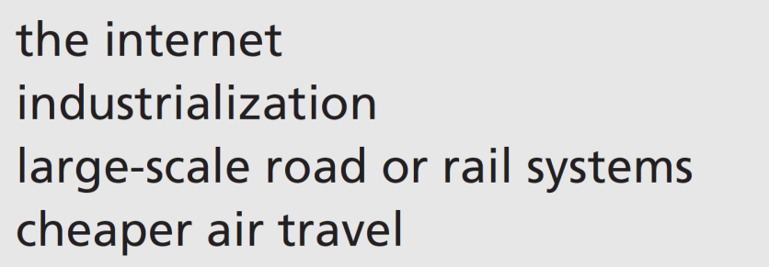
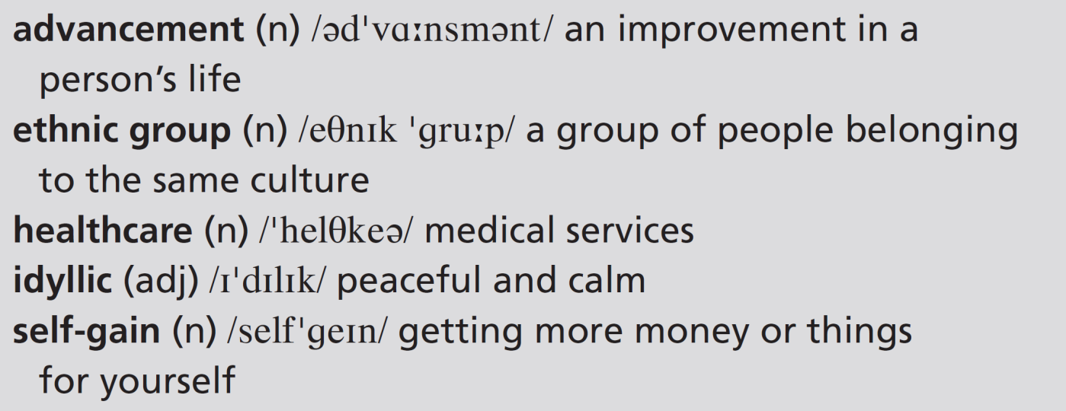
9 Work in pairs. Tourism changed the Sherpa way of life. What are the effects of these things on people’s ways of life?
EXAMPLE ANSWERS
The internet: makes the world a smaller place – we know what is happening in the world; we can communicate with people anywhere
Industrialization: people moving to the cities; lots of products available; destruction of natural habitats; pollution
Large-scale road or rail systems: people travelling; people moving to live in different places; new ideas coming into remote places
Cheaper air travel: same as above
4f-p. 55

Slide 76
UNIT 4 REVIEW AND MEMORY BOOSTER
Grammar
1 Complete each comment from student chefs with one word or contraction.
1 ‘I’m sure nobody ______________ be able to eat this!’
2 ‘I’m ______________ to change jobs soon.’
3 ‘I’ ______________ having a drink on my next break.’
4 ‘This ______________ definitely impress the diners.’
5 ‘I’m going ______________ be the best chef in the country one day.’
6 ‘My parents ______________ be so proud of me.’
7 ‘This may ______________ turn out as I expected.’
8 ‘Wow, my hat ______________ catch fire in this kitchen.’
9 ‘My friends ______________ believe me when I tell them about my day.’
10 ‘I’m ______________ a take-away for dinner tonight.’
will
going
m
will
to
will
not
might/could
won’t
getting
U4 Review-p. 56

Slide 77

2 Which comments in Exercise 1 do you think the students in the photo above might make? Why? Work in pairs and compare your ideas.
EXAMPLE ANSWERS
All of the comments could be made by the students in the photo, apart from perhaps 2.
3 Work in pairs. Find two plans and two predictions in Exercise 1. Explain the use of the verbs in each comment.
Plans:
2 ‘I’m going to change jobs soon.’
5 ‘I’m going to be the best chef in the country one day.’
Predictions:
1 ‘I’m sure nobody will be able to eat this!’
4 ‘This will definitely impress the diners.’
6 ‘My parents will be so proud of me.’
7 ‘This may not turn out as I expected.’
8 ‘Wow, my hat might/could catch fire in this kitchen.’
9 ‘My friends won’t believe me when I tell them about my day.’
U4 Review-p. 56

Slide 78
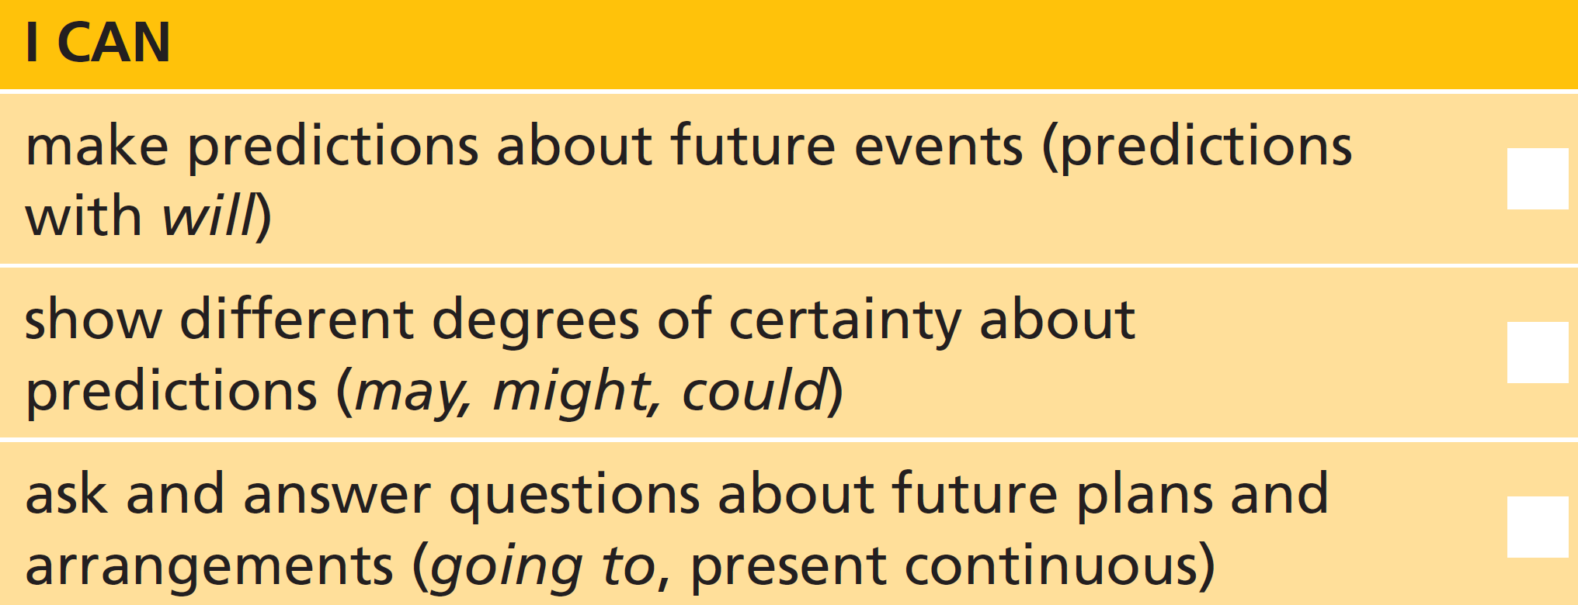
4 Work in pairs. Ask your partner about plans and arrangements they have for when your English course finishes.
U4 Review-p. 56

Slide 79
Vocabulary
5 Match the verbs (1–5) with the nouns (a–e) to make expressions about education.
e
a
d
c
b
1 apply
2 become
3 get
4 graduate
5 retake
a an apprentice
b an exam
c from university
d good results
e to college
U4 Review-p. 56

Slide 80
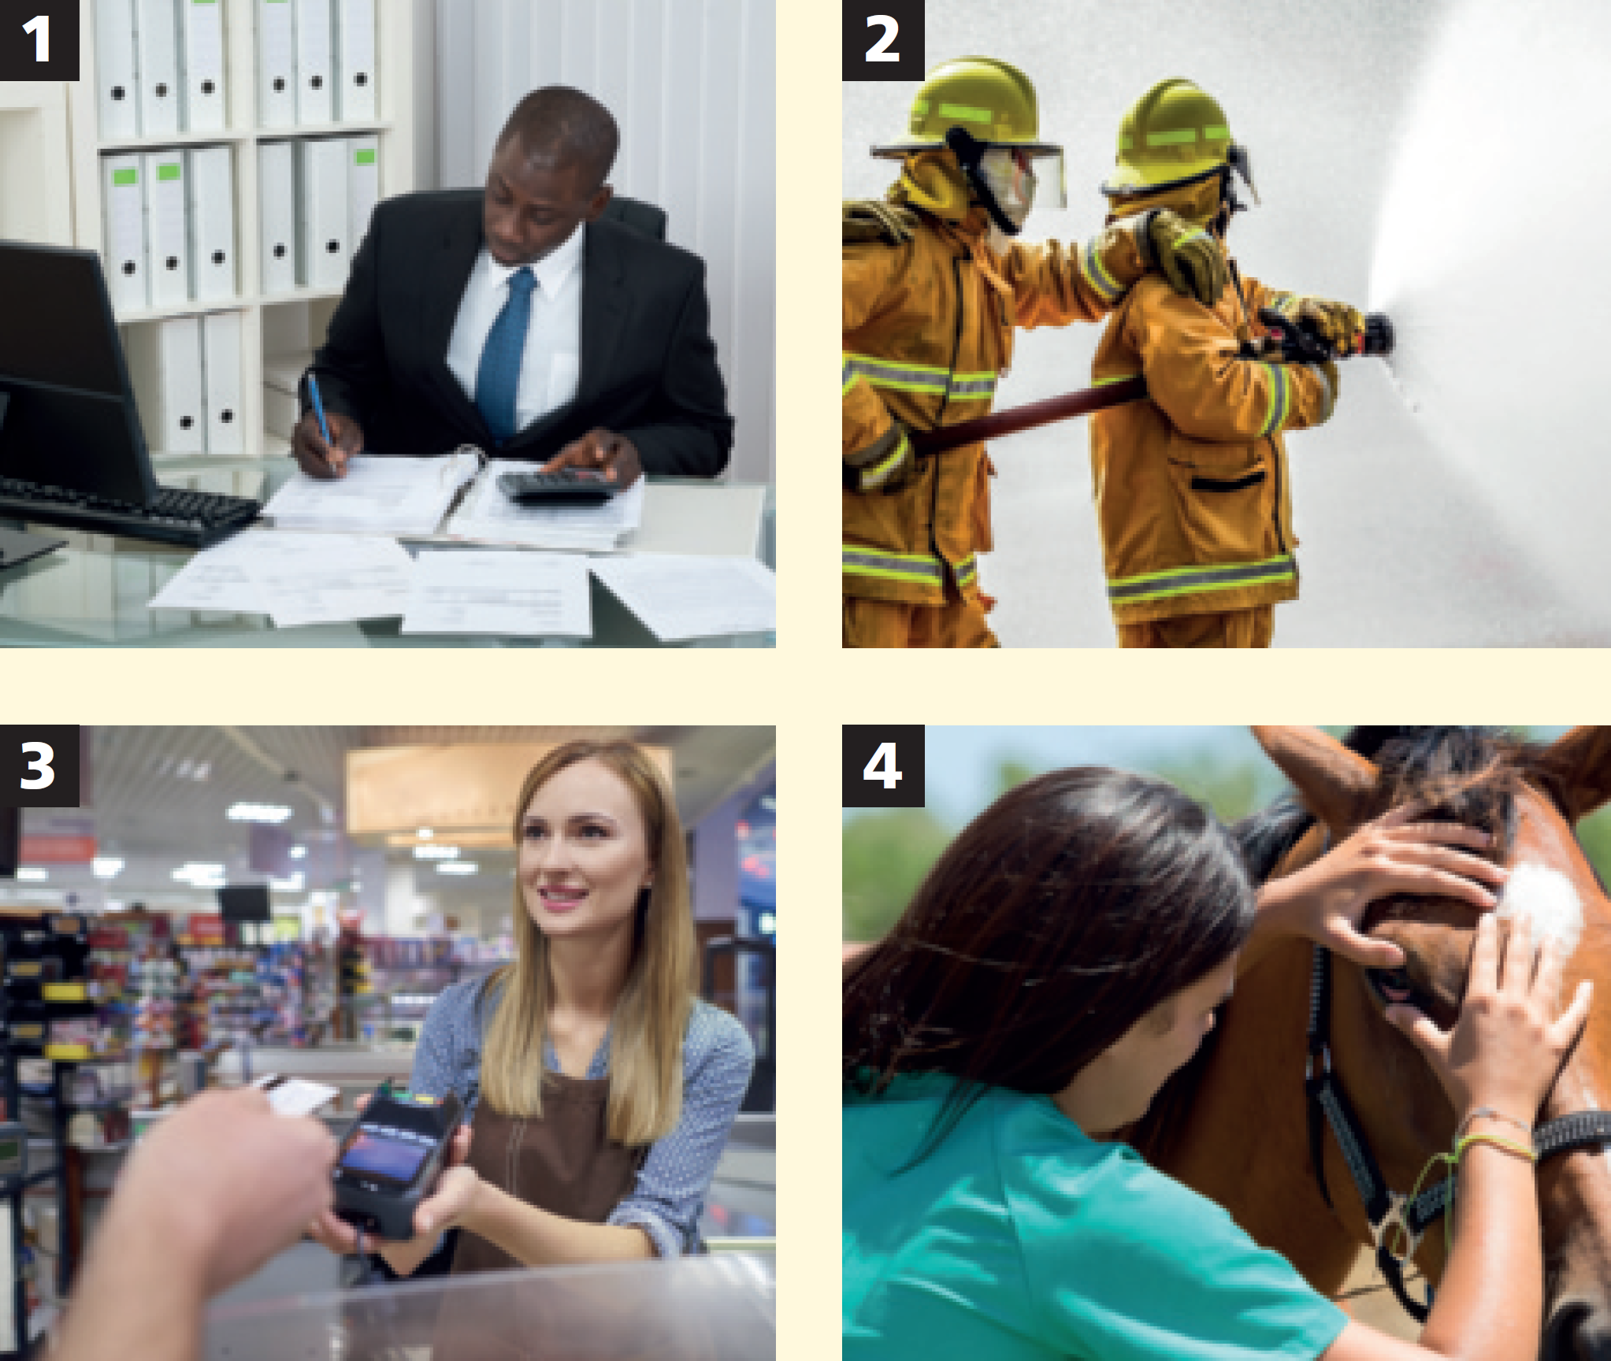
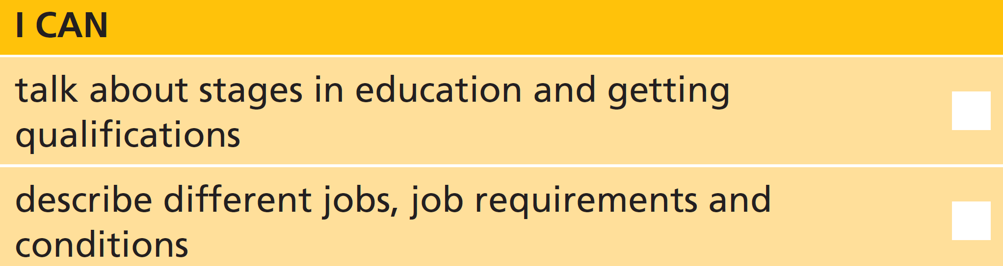
6 Work in pairs. For each of these jobs, discuss the qualities and qualifications you need, and the pay and conditions. Then say which job would be best for your partner and give reasons.
Students’ own answers
U4 Review-p. 56

Slide 81
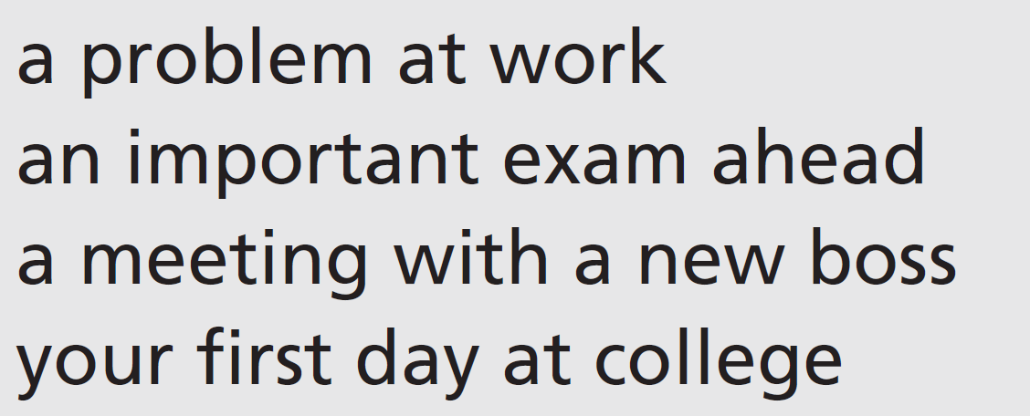

Real life
7 Work in pairs. Match the beginnings of the sentences (1–4) with the endings (a–d). Then act out a conversation which includes the requests and appropriate replies.
b
a
c
d
1 Could you
2 Is it all right if I
3 Would you mind
4 Would it be all right if I
a borrow your phone?
b help me with this application?
c lending me some money?
d took off my jacket?
8 With your partner, act out similar conversations for two of these situations.
U4 Review-p. 56

Slide 82
Communication activities
Unit 4d Exercise 8, page 52
Student A: Choose a number (1–12). You are going to make this request.
Student B: Look at your partner’s number. Choose an appropriate situation (a– d) for this request. You are going to respond to the request.
Act out a conversation in this situation. Use the expressions on page 52 to help you. Take turns to make requests and respond.
Request
Situation
1 You want to sit down.
2 The phone number on a letter isn’t clear.
3 You don’t know where the company buildings are.
4 You want an application form sent in the post.
5 You haven’t got a pen.
6 You need a taxi.
7 You need to know the time.
8 You want help with an application form.
9 You need a lift somewhere.
10 You want to leave your coat somewhere.
11 You want to wash your hands.
12 You want to use the phone.
a You’re with a friend.
b You’re in the reception area of a company.
c You’re in an interview.
d You’re on the phone.
p. 155

